Slide 1
Advertisement of Fast Food Products
Name
Institution Affiliation

Slide 2
Agenda
Ethical Standards for advertising the Fast Foods
The effects of advertising on the American culture
Primary strategies used in persuading clients in advertising
School advertising
Children in advertising
Politics in advertising
Health in advertising
Creative and appealing commercial
Elements that are unusual in commercial
Target group
Consumers appeal
Effectiveness in brand name recognition
Meeting the ethical standards
References

Slide 3

Ethical Standards for Advertising the Fast foods
There are 8 principles and practices for advertising (Andreyeva et al., 2016)
There should be a clear separation of paid advertising from news.
Maintenance of the utmost truth and high standards of ethics.
There should be a clear disclosure of all material conditions.
There must be highest personal ethics when creating commercials
The consumers privacy must be maintained at all times
All the consumers must be treated fairly
Potential ethical concerns must be privately discussed
There are federal, state and local advertising laws that should be followed

Slide 4
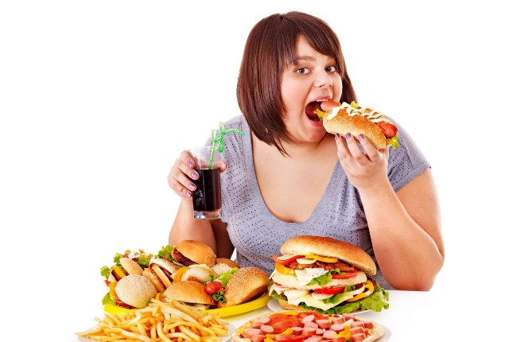
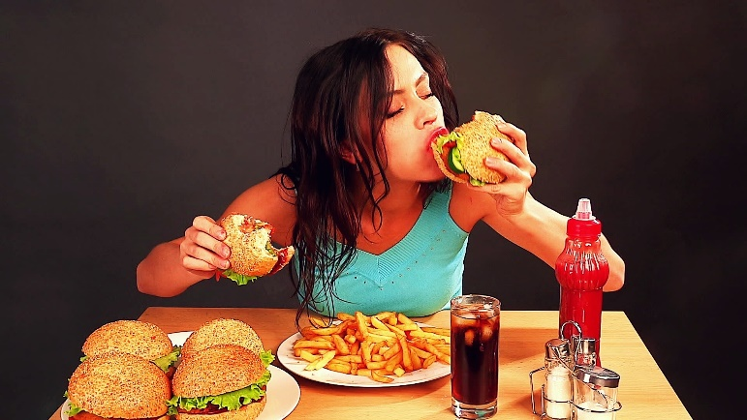
The Effects of Advertising on the American Culture
Impacts the values of the consumers.
Brings unrealistic expectations about a product.
It stifles choice instead of promoting the same.
Leads to unhealthy eating habits in the society.
Fast food advertisements make the foods look like the best

Slide 5
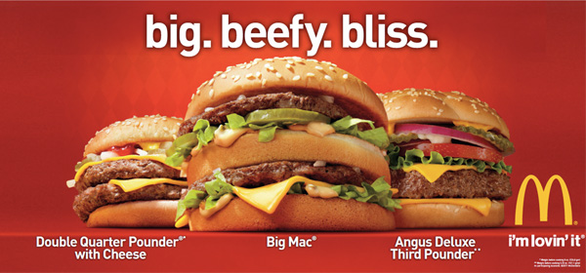
Primary Strategies used in Persuading Clients in Advertising the product
Promotions- Used in enticing consumers to purchase a product
Repetitions- Helps in keeping the brand at the forefront of a consumer’s mind
Bandwagon- Where consumers are convinced using a group mentality. For example, saying a particular group uses the product
Claims- May include misleading information between the overall message and the message on the prints.
Association- Includes associating a product with a famous person or a catchy jingle

Slide 6
School Advertising
The states in the US have regulations with regards to advertisements of fast foods in the schools (Andreyeva et al., 2016).
Those in favor of the advertisements assert that it helps in raising money for school districts.
Those against the advertisements like the fast foods ads say some adverts easily persuade the children and the fast foods are not good for their health.
Schools are a big and easy targets for selling the products since the children in the schools can easily be convinced.
Some schools have banned advertising in their compounds and it can only be done a few miles away from the schools (Kelly et al., 2016).

Slide 7
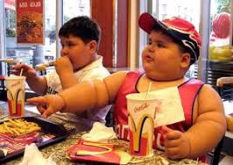
Children in Advertising
Objectifying children in the advertisements leads
low self esteem among them.
Low self esteem issues may lead to unhealthy
weight control actions and behaviors like diet
pills and skipping meals.
Body dissatisfaction and concerns that are related to weight amongst the children
The risk of weight bias marginalization may arise
Most of the images in food advertising target children who are linked to obesity

Slide 8
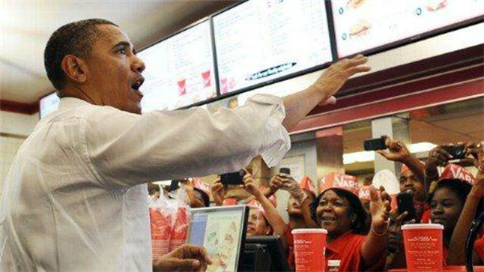
Politics in Advertising
There are truth and false claims when advertising the fast foods, the aim being to gain a political millage.
Advertisers identity. The person in the advert can influence consumers
Equal opportunity. Are
the companies
enjoying equal
opportunities
Compliance. Are those
advertising in politics
complying with ethics
rules.

Slide 9
Health in Advertising
The fast food industry has taken over the advertising airwaves and are doing their businesses without caring about consumers health.
They keep on advertising foods that do not have nutrients and are not healthy. All they want is to make money.
They also advertise large portions and sizes that are unhealthy and may lead to obesity when taken for a long period.
Most of the consumers are getting physically unfit because of consuming the fast foods in excess.
The fast foods ads are mostly persuasive and when people consume the foods for a long time, it may lead to diseases.

Slide 10
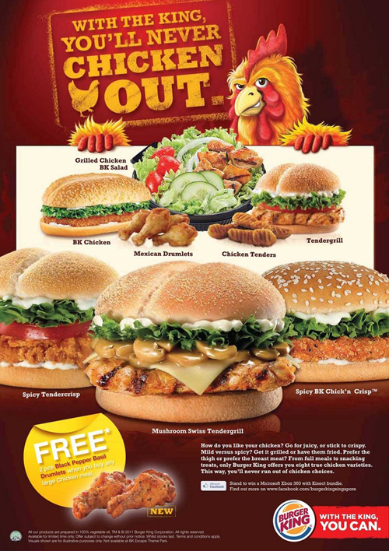
Creative and Appealing Commercials
Fast foods commercials are very creative, appealing and inescapable.
They easily convince the target audience that they are the best foods, cheap and easily available.

Slide 11
Elements that are Unusual in Commercials
The advertisement and talk of eating unhealthy foods. In the advertisements, the advertisers advertise eating of the unhealthy foods. They do not care about the health of the consumers. They only care about their businesses.
Different fast foods company attacking each other’s products. For example, company A saying company’s B products are unhealthy and in real sense, both the companies offer fast foods (Andreyeva et al., 2016) .
The way they advertise a meal but when you go to the restaurant you find it is not exactly what they were saying on television.
Advertising using other companies products to build a name, but in real sense, the company does not offer such a product (Kelly et al., 2016).

Slide 12
Target Group
Children- They can easily be influenced by the commercials.
Families- A family that is very busy and have no time to cook at home can decide to have fast foods as the easiest way of getting food.
Healthy Eaters. They are people who eat healthy foods. They are the untapped market for the fast foods and most of the fast food ads target this ‘new’ market
Athletes- They require a lot of energy. When the adverts for fast foods run, most of them advertise how the foods can easily bring energy.
Middle aged people- Most of the middle aged people are in the years where they want to explore different things and foods. Most of the fast foods have a lot of carbs and sugar, that is what the middle aged people like despite the excess carbs and sugar being unhealthy.

Slide 13
Consumers Appeal
Consumers appeal is a product’s or company's brand name attractiveness to customers. It is what appeals to the consumers.
Healthy Eating. Despite eating the unhealthy foods, most consumers want to eat healthy. Some consumers actually think that the fast foods are healthy.
Fresh foods. Consumers desire to eat food that is fresh.
Avoidance of greasy unhealthy foods. They are foods that will harm a consumers body and cause diseases.
Funny and creative adverts. They mostly appeal to children who convince their parents to buy the fast foods.

Slide 14

Effective Brand Recognition
Effective brand recognition refers to the extent in which a consumer can recognize a brand by looking at its attributes like its logo or packaging. Example

Slide 15
Meeting the Ethical Standards
Fast food businesses will benefit if they formulate and ensure a code of ethics is implemented to the later.
That can serve as a benchmark for decision making in running the business and ensuring the consumer benefits in as much as the owner.
The management of these businesses must ensure the safety of their foods comes first. The foods should be fresh and prepared by qualified chefs.
There should also be a minimum set standards of products that are supplied for foods to be made. The supplier must deliver quality products.
The people preparing the foods must be clean, have good healthy and understand the guidelines when making food for human consumption.

Slide 16
References
Andreyeva, T., Kelly, I. R., & Harris, J. L. (2016). Exposure to food advertising on television: associations with children's fast food and soft drink consumption and obesity. Economics & Human Biology, 9(3), 221-233.
Kelly, B., Halford, J. C., Boyland, E. J., Chapman, K., Bautista-Castaño, I., Berg, C., ... & Grammatikaki, E. (2014). Television food advertising to children: a global perspective. American journal of public health, 100(9), 1730-1736.

